Slide 1
Ruby Training: Strings
Matthew Eakin, Manager
Managed Testing Practice
Sogeti, USA
Matthew.Eakin@us.sogeti.com

Slide 2

Course Agenda
Creating the Strings Project
Creating the strings.rb File
Strings
What is a string
Expression substitution
Escape (non-printable) characters
Referencing Strings
Removing white spaces from Strings
Other fun String methods

Slide 3
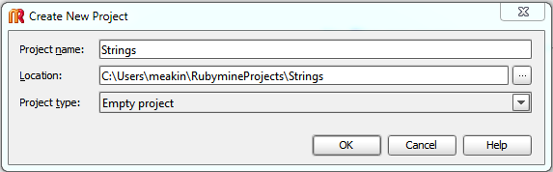
Creating the Strings Project
To create a new Project in RubyMine:
Select File -> New Project…
Project name = Strings
Location – use the default value
Project Type = Empty project
Notes:
1. TDD is a development methodology where test scripts are written 1st, then production code is written to the script. TDD cycle (script fail -> write code -> script pass -> refactor code). Originally these were unit test scripts. Problem: still didn’t sync with what the business wanted or what user did. Answer: Agile teams began using acceptance test scripts and the process took off.
2. Strategy and Planning are continuous in agile (more on this in a minute) and constantly being re-evaluated
3. The testing world is changing (I’ll cover these changes in the next 2 slides). If you don’t adapt the testing effort will suffer and be an impediment rather than an enabler. Agile is all about team.
I’ll cover more of this in a little bit. Automation is the future of testing.
Question: why do we believe what we believe?

Slide 4
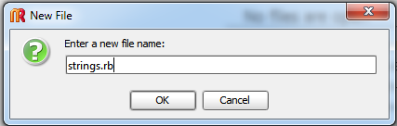

Creating the Strings File
To create a new File in RubyMine:
Right-click where you want to put the file
Select New -> File
File name = strings.rb
The .rb extention is very important as it tells the system the file is a Ruby file
Should end up with…

Slide 5
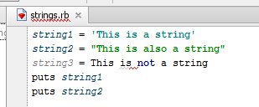
Strings
Definition: Strings are a way to represent text in Ruby
Simple strings can be written 2 ways:
With a single tic: ‘This is a string’
Or with the double tic: “This is also a string”
You definitely need a tic: This is not a string
Write this code:
string1 = ‘This is a string’
string2 = “This is also a string”
string3 = This is not a string
puts string1
puts string2

Slide 6
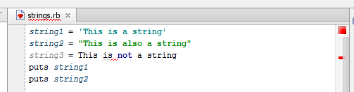
Your first RubyMine error indicator
RubyMine lets you know what is going on:
The single tic text turns blue
The double tic text turns green
You have an error and RubyMine is not shy about letting you know

Slide 7

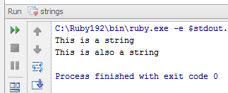
Your first code fix
Fixing this code is simple:
Comment out the entire line
or
Double tic the entire line
Now Run the file
You should get the following output

Slide 8
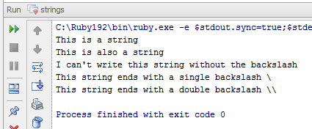
Working with “\” in strings
Ruby enables you to handle apostrophes in a string by using the “\”
‘I can\’t write this string without the backslash’
If you need to include a “\” in a string, all you need to do is “\\”
‘This string ends with a single backslash \\’
‘This string ends with a double backslash \\\\’
Write and Run this code Output should look like this:
puts 'I can\'t write this string without the backslash'
puts 'This string ends with a single backslash \\'
puts 'This string ends with a double backslash \\\\'

Slide 9
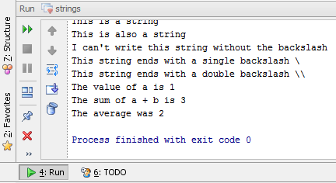
Expression Substitution
Ruby enables you to embed any Ruby expression into a string
Use the following symbols: #{}
You must use “, you cannot use ‘
Code Example: Will get you this output:
a, b, c = 1, 2, 3
puts “The value of a is #{a}”
puts “The sum of a + b is #{a + b}”
puts “The average was #{(a + b + c)/3}”

Slide 10
Escape Characters
Ruby has numerous escape (non-printable) characters available using backslash notation
Backslash notation | Hexadecimal character | Description
\a | 0x07 | Bell or alert
\b | 0x08 | Backspace
\cx |  | Control-x
\C-x |  | Control-x
\e | 0x1b | Escape
\f | 0x0c | Formfeed
\M-\C-x |  | Meta-Control-x
\n | 0x0a | Newline
\nnn |  | Octal notation, where n is in the range 0.7
\r | 0x0d | Carriage return
\s | 0x20 | Space
\t | 0x09 | Tab
\v | 0x0b | Vertical tab
\x |  | Character x
\xnn |  | Hexadecimal notation, where n is in the range 0.9, a.f, or A.F

Slide 11
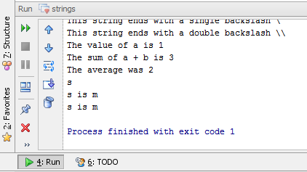
Referencing Strings
Ruby allows you to reference any part of a string using the following syntax:
str[fixnum] – returns the character at fixnum
str[fixnum1, fixnum2] – returns a sub-string starting at fixnum1 and ending fixnum2 characters later
Ruby has another method for referencing strings, the slice function
str.slice(fixnum1, fixnum2) – returns a sub-string starting at fixnum1 and ending fixnum2 characters later
Code Example: Will get you this output:
string4 = “This is my test string”
puts string4[3]
puts string4[3,6]
puts string4.slice(3, 6)

Slide 12
Other commonly used String methods
downcase – returns a copy of string with all uppercase letters replaced with lowercase
str.downcase – will turn “ALL CAPS” string into “all caps”
upcase – returns a copy of string with all lowercase letters replaced with uppercase
str.upcase – will turn “all downs” string into “ALL DOWNS”
Ruby provides a way to strip out leading and/or training white spaces with the lstrip, rstrip and strip commands
str.lstrip – will turn “ white spaces” string into “white spaces”
str.rstrip – will turn “white spaces ” string into “white spaces”
str.strip – will turn “ white spaces ” string into “white spaces”

Slide 13
More commonly used String methods
length – asks the question: what is the length of the string?
str.length #returns an integer of the length of the string
empty? – asks the question: is the string empty?
str.empty? #returns true or false if string is empty
eql?(other string) – asks the question: is this string equal to another string?
str1.eql?(str2) #returns true or false if the strings are equal

Slide 14
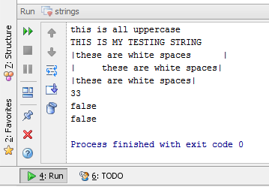
Wrap-Up Exercise
Write this Code and run it: Will get you this output:
string5 = "THIS IS ALL UPPERCASE"
puts string5.downcase
puts string4.upcase
string6 = " these are white spaces "
puts "|#{string6.lstrip}|"
puts "|#{string6.rstrip}|"
puts "|#{string6.strip}|"
puts string6.length
puts string6.empty?
puts string6.eql?(string5)

Slide 15
Thank you

